Slide 1
Social Media Application
Youssef El-Mahdy / section 4 / 1000104492

Slide 2
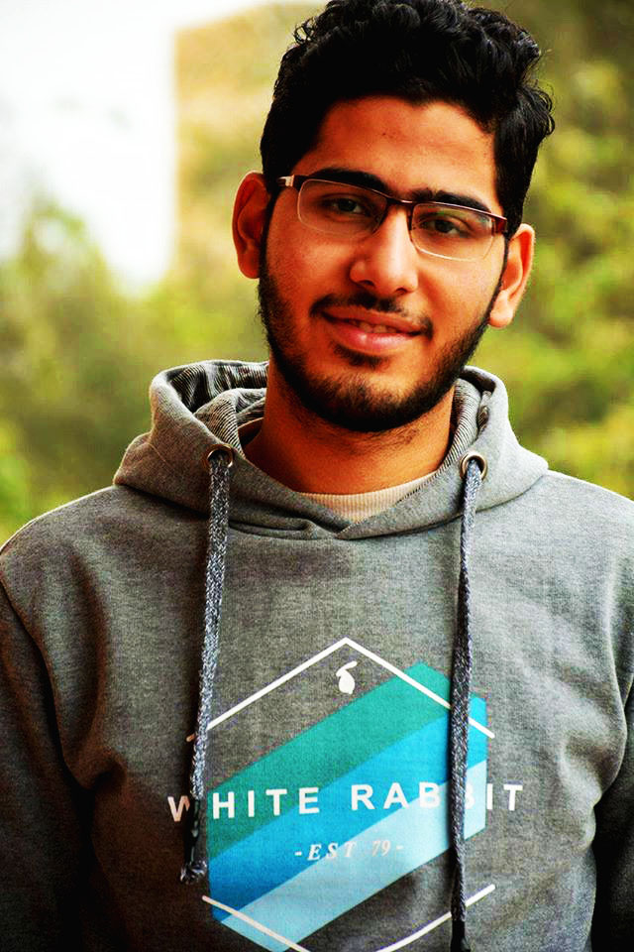
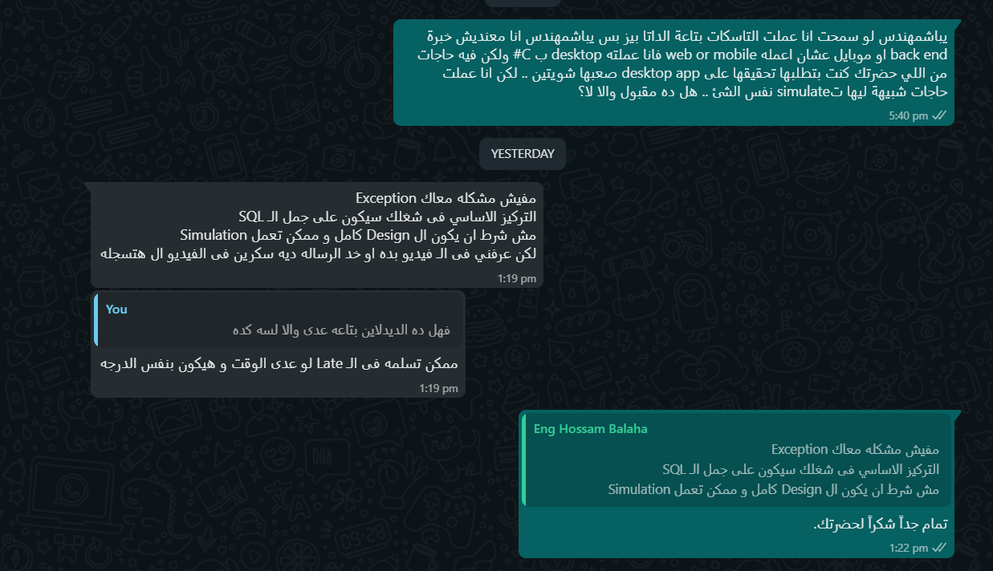
Who am I?

Slide 3
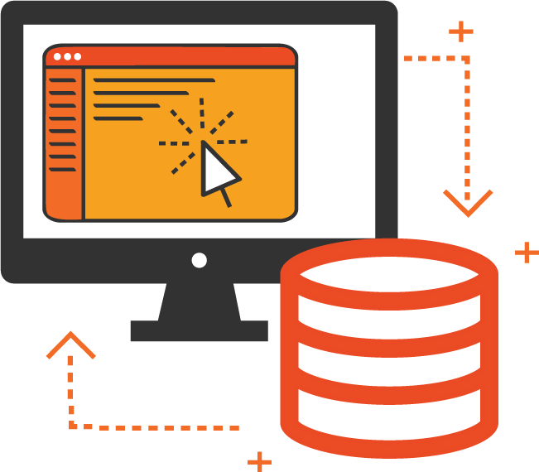
OS, DBMS & Programming Language used

Slide 4

Overall Working Mechanism

Slide 5

Functions & Blocks

Slide 6

SQL Statements

Slide 7

Test cases
(LET THE FUN BEGIN ☺)

Slide 8

Learning Outcomes

Slide 9
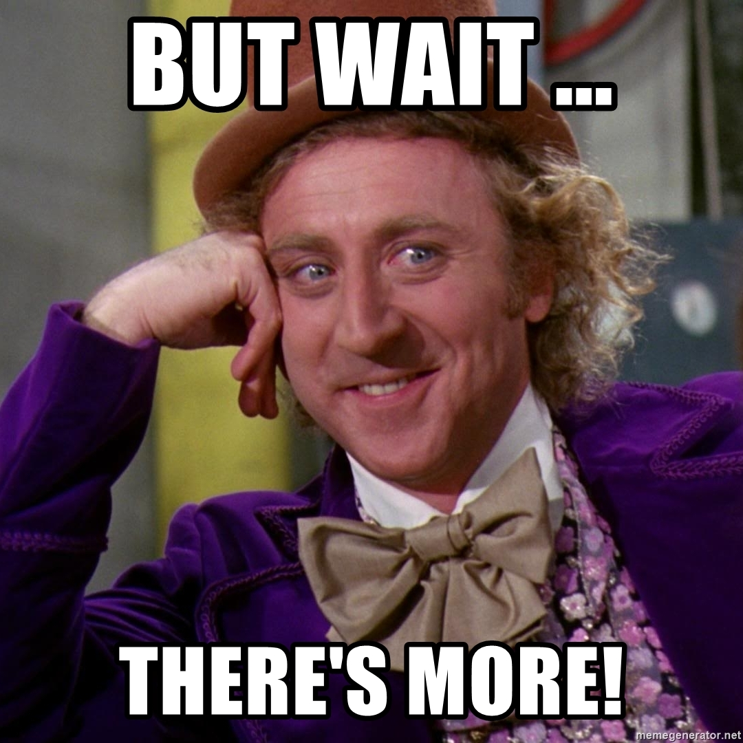

Slide 10
Thank You For Everyhing

